Slide 1
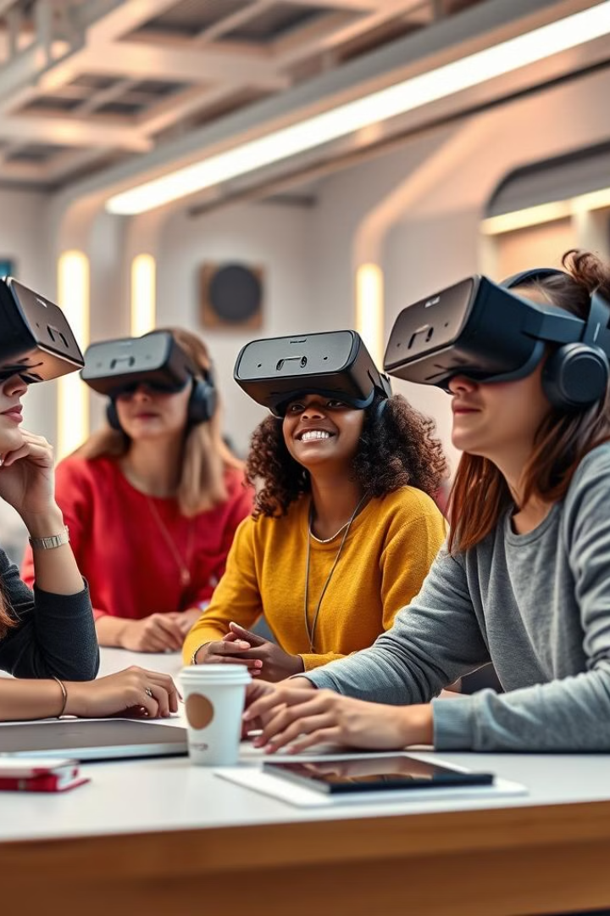

Meta: Metaverse for Global Education Access
Meta envisions a future where education transcends geographical boundaries. The metaverse empowers learners worldwide through immersive experiences.
by Misha Ganji
(22071A6716-CSE-DS-A)

Slide 2
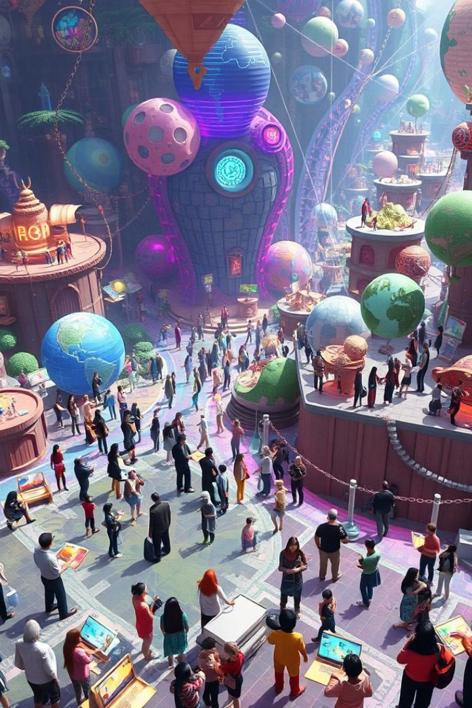
What is the Metaverse?
1
Virtual Worlds
2
Immersive Experiences
The metaverse is a network of interconnected, persistent virtual worlds. Users interact as avatars.
It offers immersive experiences, blurring the lines between physical and digital realities.
3
Social Interaction
The metaverse facilitates social interaction, collaboration, and shared experiences in virtual spaces. It's always evolving.

Slide 3
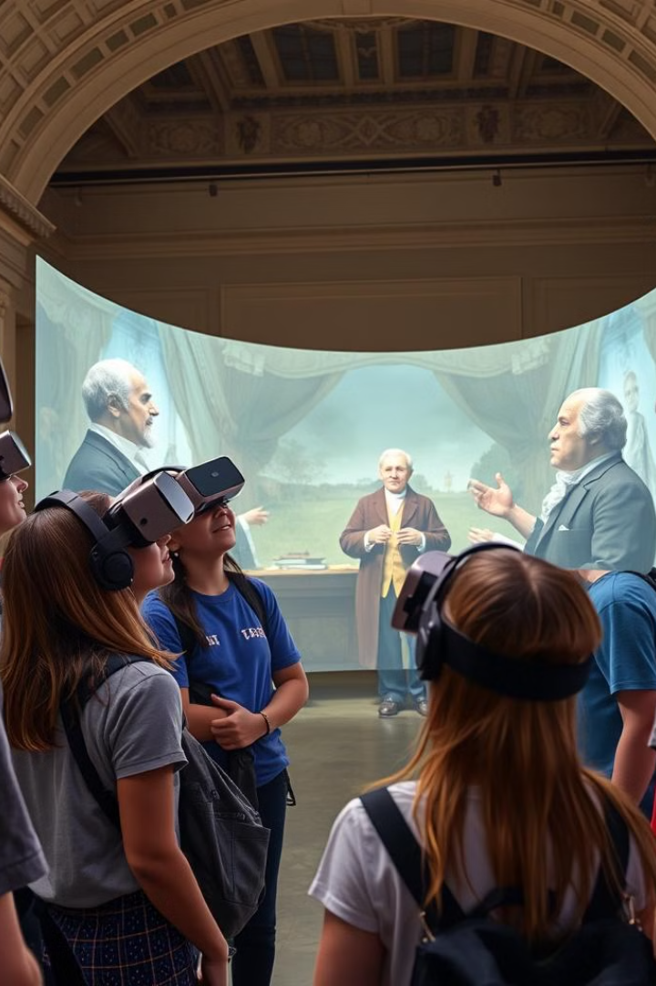
The Potential of the Metaverse in Education
Accessibility
Engagement
Education becomes accessible to anyone, anywhere, regardless of location or socioeconomic status.
Immersive experiences enhance student engagement and knowledge retention. Learning becomes fun.
Collaboration
Innovation
Virtual classrooms foster collaboration and peer-to-peer learning in dynamic environments.
The metaverse offers new tools and methods for teaching and learning.

Slide 4
Democratizing Education through Virtual Classrooms
Global Access
Equal Opportunities
Flexibility
Virtual classrooms eliminate geographical barriers. Students can attend class from anywhere.
Underserved communities gain access to quality education and resources.
Students can learn at their own pace, anytime, anywhere.

Slide 5




Accessible Education for Underserved Communities
Bridging the Gap
Removing Barriers
Empowering Learners
The metaverse bridges the educational divide, bringing learning opportunities to remote areas.
It eliminates financial and logistical barriers that prevent access to quality education.
Underserved students gain access to transformative learning experiences, unlocking their full potential. They can succeed.

Slide 6
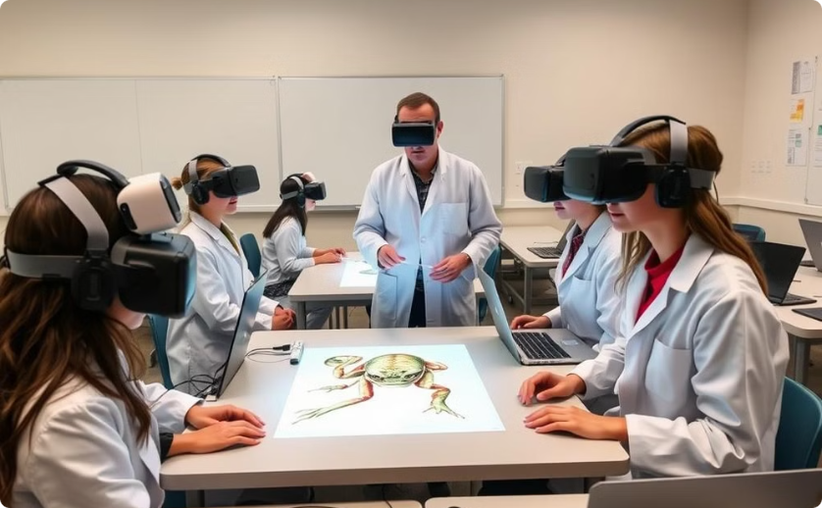
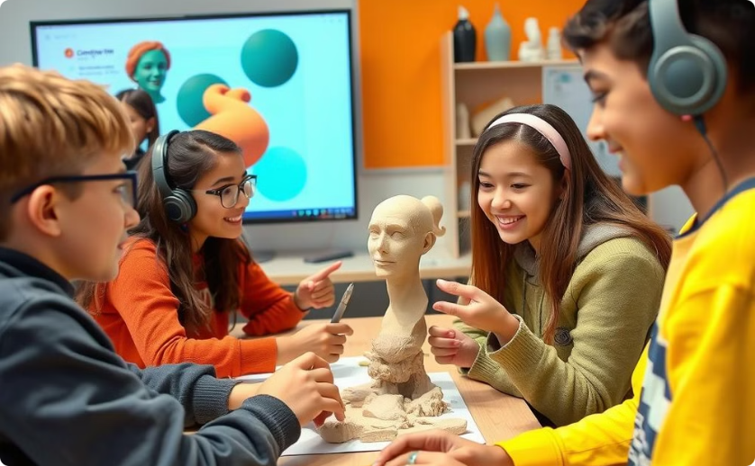
Immersive Learning Experiences in the Metaverse
Interactive Simulations
Gamified Learning
Students participate in interactive simulations and virtual field trips, making learning memorable.
Gamified learning experiences increase motivation and engagement. They make learning fun.

Slide 7




Virtual Labs and Interactive Learning Environments
Virtual Labs
Students can conduct experiments in safe, virtual labs. This access is cost-effective.
Global Collaboration
Students collaborate with peers worldwide on projects and experiments.
Interactive Tools
Interactive tools and simulations enhance understanding of complex concepts.

Slide 8
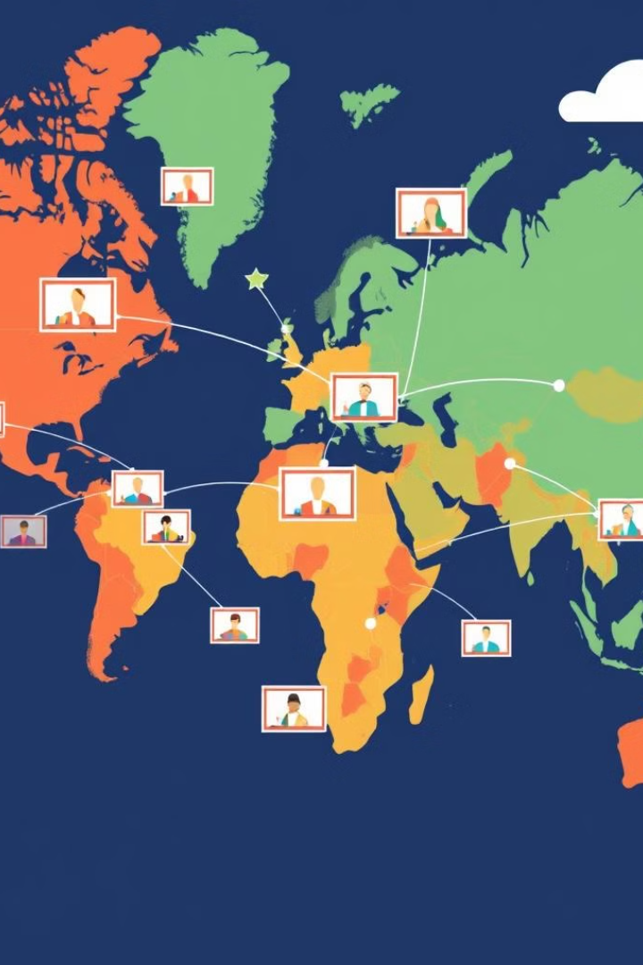
Overcoming Geographical Barriers to Education
1
Connecting Learners
The metaverse connects learners globally, regardless of their physical location.
2
Equal Access
Students in remote or underserved areas gain equal access to educational opportunities.
3
Global Classrooms
Diverse perspectives enrich the learning experience.

Slide 9

Scalable and Cost-Effective Education Solutions
1
Reduced Costs
2
Increased Reach
3
Personalized Learning
Virtual classrooms reduce infrastructure and operational costs. Physical resources are not needed.
The metaverse allows institutions to reach a wider audience. More students benefit.
AI-powered tools personalize learning paths.

Slide 10
Challenges and Considerations for Metaverse in Education
Digital Divide
Data Privacy
Pedagogical Approaches
Addressing the digital divide is crucial for equitable access. Internet is needed.
Protecting student data and privacy is paramount.
Developing effective pedagogical approaches for virtual learning is essential. Teachers need training.

Slide 11


